Slide 1



UNIT 6: Around the world
Tia’s year

Slide 2


Look at the pictures and answer the question.
What’s the weather like today?
New York
Sydney
Dublin

Slide 3


Look at the pictures and answer the question.
What’s the weather like today?
Johannesburg
Mumbai
Helsinki

Slide 4
Do you have a birthday party on your birthday?
When do you have a birthday party?
How often do you visit your grandparents?
Do you ever go hiking?
When do you go shopping for presents?
Who do you buy presents for?

Slide 5
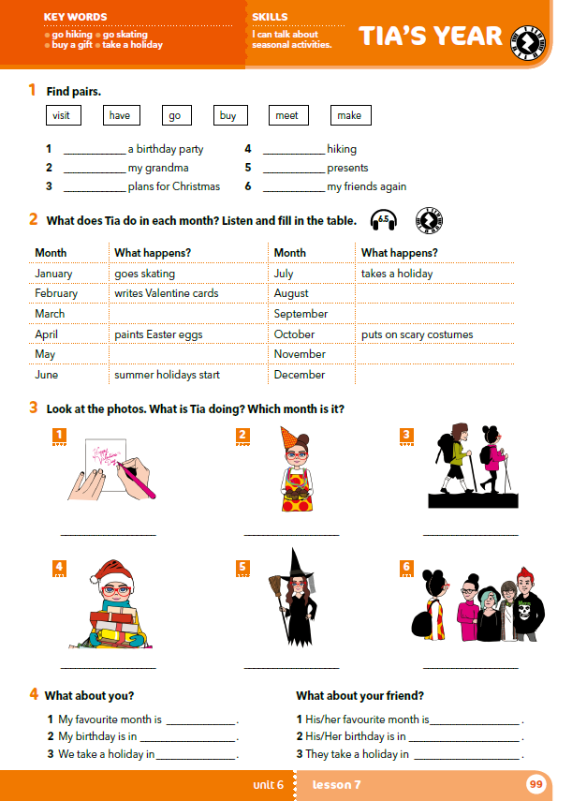
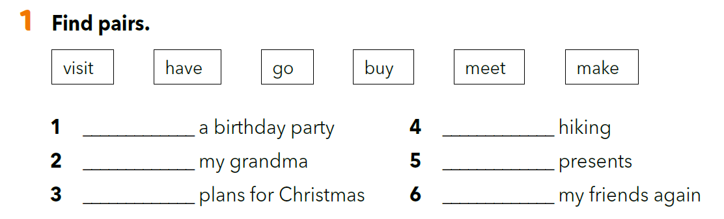
have
go
visit
buy
make
meet

Slide 6
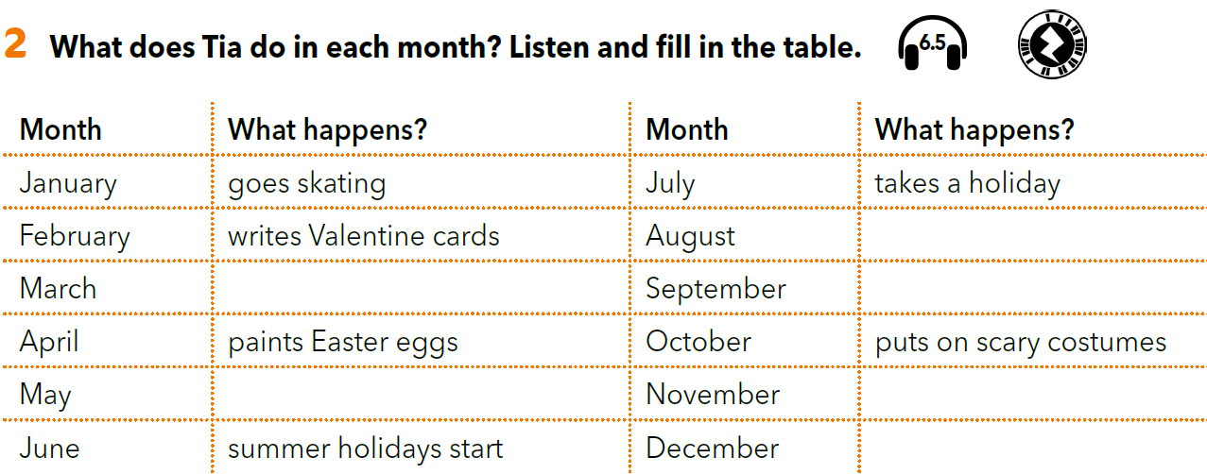
What month does Tia paint Easter eggs in?
What does Tia do in February?
What month does Tia put on scary costumes in?
What does Tia do in July?
What month does Tia go skating in?
What starts in June?

Slide 7

https://www.e-sfera.hr/dodatni-digitalni-sadrzaji/de1eb37f-b55d-488c-a002-e1601af4710b/assets/audio/48_tia_year.mp3
For which months are there no activities?
Look at the activities in task 1 – can you match them with the months?
visits her grandma
has a birthday party
school starts
goes hiking and rides her bike
makes plans for Christmas holidays
goes shopping and buys presents for her family and friends

Slide 8
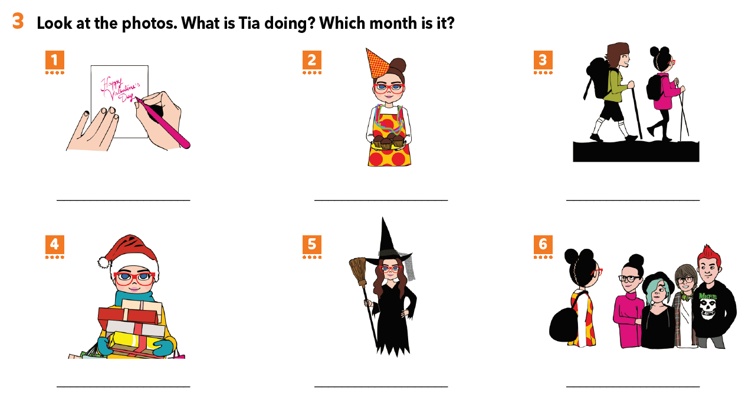
Describe the photos. Answer the questions in full sentences.
She is writing Valentine cards. It is February.
She is having a birthday party. It is March.
She is hiking. It is May.
She is buying Christmas presents.
It is December.
She is putting on scary costumes. It is October.
She is back to school. It is September.

Slide 9
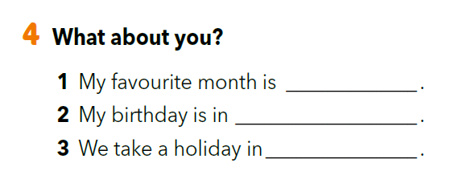
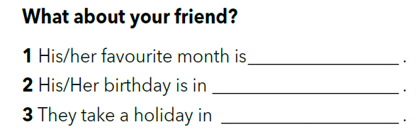

Slide 10
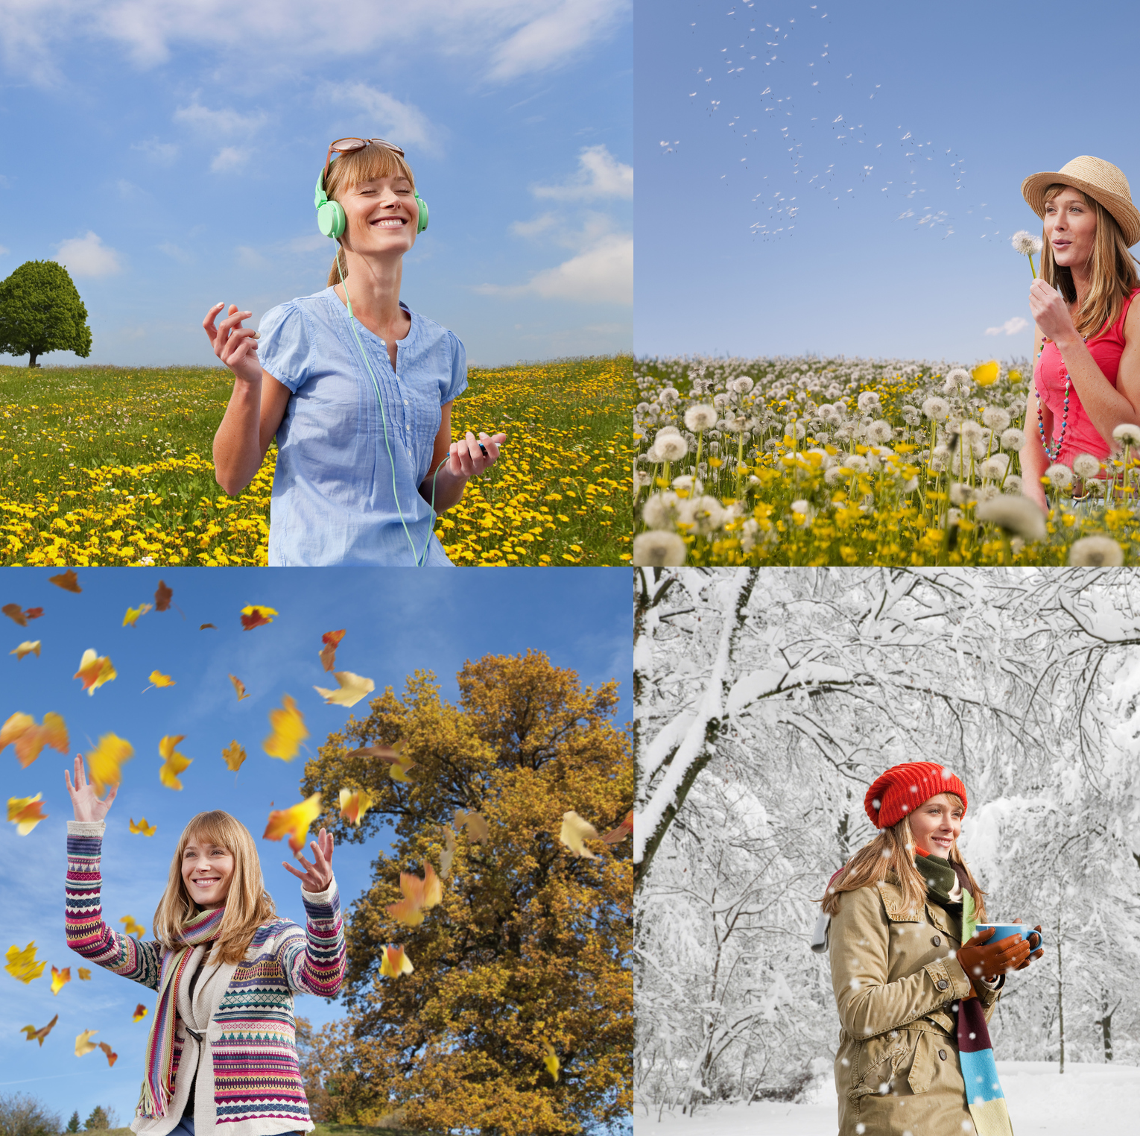
PROJECT TIME
My seasons of the year
Podijeli A3 papir na četiri dijela i svaki od dijelova posveti jednom godišnjem dobu i načinu na koji tvoja obitelj i zajednica to godišnje doba obilježavaju, tj. koji su vaši običaji i navike.

Slide 11
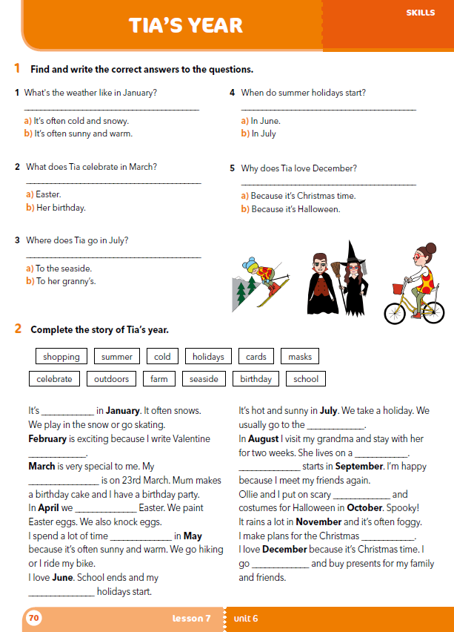
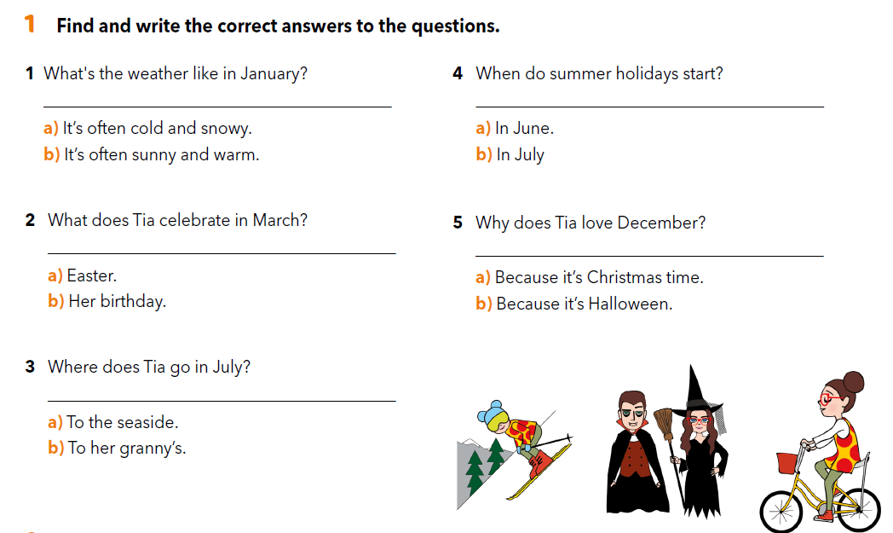
workbook p. 70
It’s often cold and snowy.
In June.
Her birthday.
Because it’s Christmas time.
To the seaside.

Slide 12
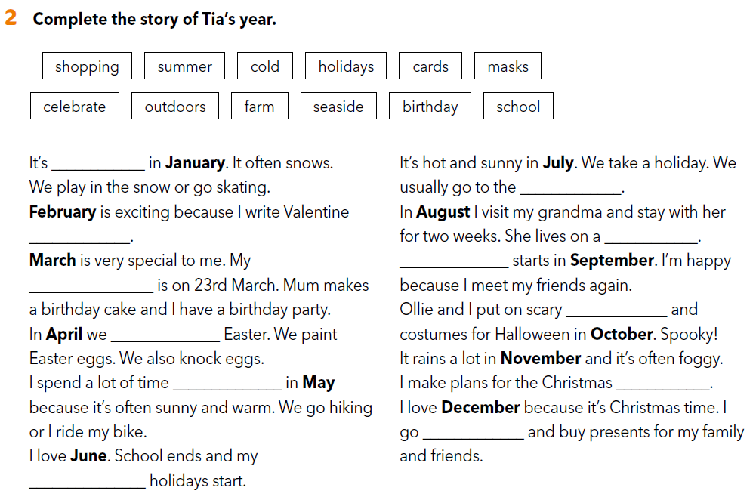
cold
seaside
cards
farm
school
birthday
masks
celebrate
outdoors
holidays
shopping
summer

Slide 13
LET’S REVISE!
https://wordwall.net/play/260/263/459
https://wordwall.net/resource/260268/tias-year-look-photos-what-tia-doing-which-month

Slide 14

LEARN MORE
https://www.e-sfera.hr/dodatni-digitalni-sadrzaji/de1eb37f-b55d-488c-a002-e1601af4710b/
Months of the year

